Slide 1
MAJOR 2 PROJECT PRESENTATION
BLOOD BANK WEB APPLICATION
JAYPEE UNIVERSITY OF ENGINEERING AND TECHNOLOGY GUNA, MADHYA PRADESH
NAME-
Enr. No.
JANU SINGH
JYOTI SINGH
SACHIN SINGH
211B152
211B157
211B261
BTECH 4th Year (8th Sem)
BRANCH-CSE
PROJECT NO.- RP-08
MENTOR:-
Dr. RAHUL PACHAURI

Slide 2
TABLE OF CONTENT
Problem Statement
Objective
Methodology
Tools and Technology
Use Case Diagram
Class Diagram
Key Features
MERN Stack Overview
Application Architecture
Result

Slide 3
PROBLEM STATEMENT
Problem Statement for Blood Bank Web Application :-
Lack of Quick Access to Blood
Unorganized Blood Donation System
Blood Shortage in Hospitals
No Centralized Database
Manual and Inefficient Process
Lack of Awareness & Engagement
Difficulty in Finding Rare Blood Groups
Need for a Secure & Transparent System

Slide 4
OBJECTIVE
The web application aims to create :-
Efficient Blood Donor-Recipient Connection
Real-Time Blood Availability Tracking
Easy Blood Donation Registration
Emergency Blood Request System
Secure and Verified Donor Database
Automated Notifications & Reminders
Awareness and Promotion of Blood Donation
Location-Based Search for Blood Banks & Donors
Efficient Management for Blood Banks
User-Friendly and Accessible Platform

Slide 5
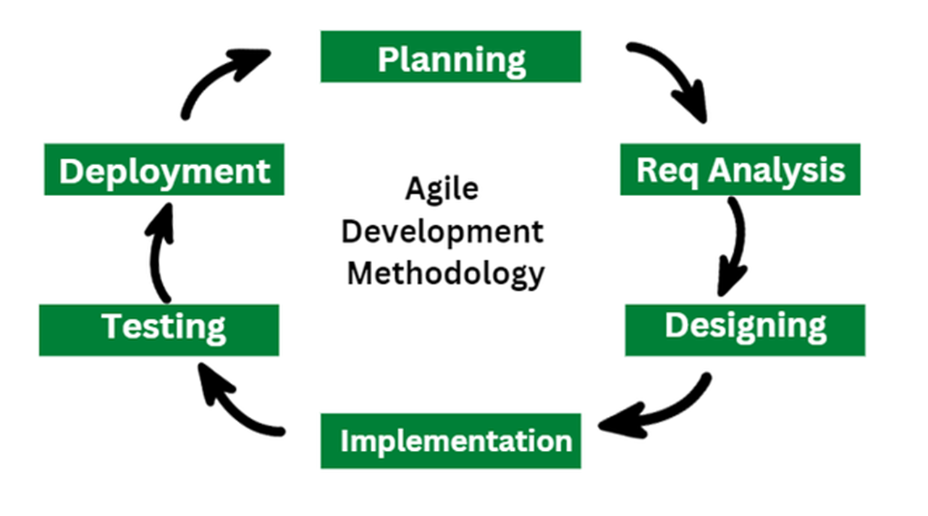
PHASES
Figure No.- 1

Slide 6
TOOLS AND TECHNOLOGY
Frontend : HTML, CSS(Bootstrap), JavaScript
Backend : Node.js, Express.js
Database: MongoDB
Code Editor : VS Code
Version Control : Git/Github
Authentication : JWT, bcrypt(for Password hashing)
Other Tools : Postman (For Test APIs)

Slide 7
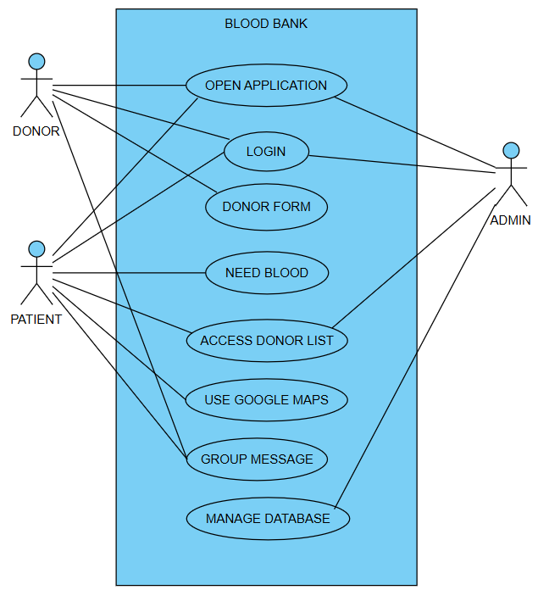
USE CASE DIAGRAM
Figure No.- 2

Slide 8
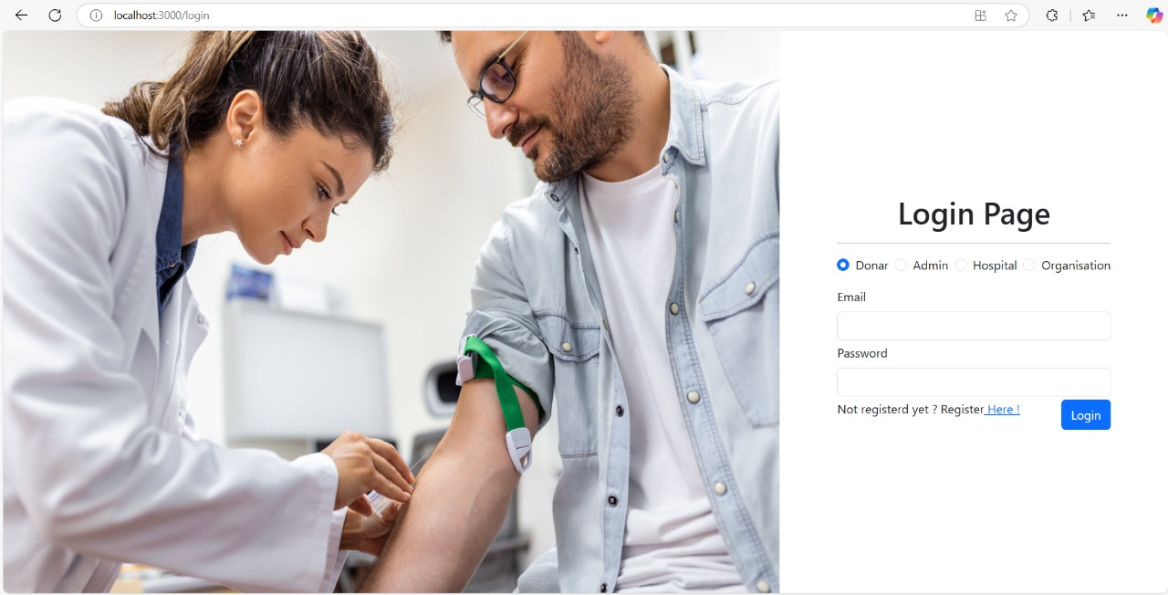
LOGIN PAGE
Figure No.- 3

Slide 9
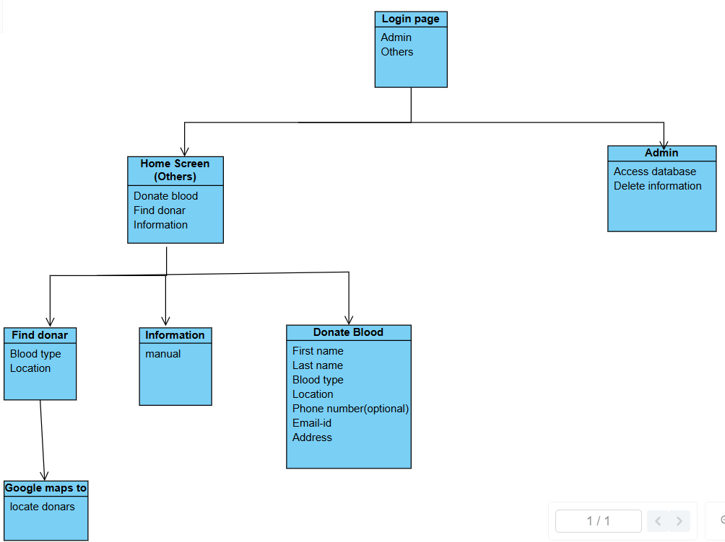
CLASS DIAGRAM
Figure No.-4

Slide 10
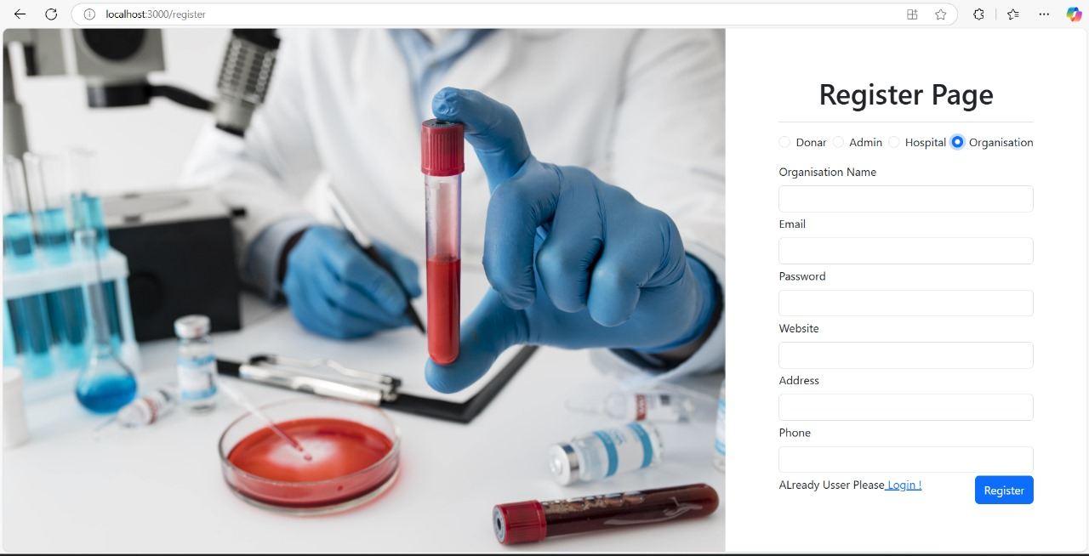
REGISTER PAGE
Figure No.- 5

Slide 11
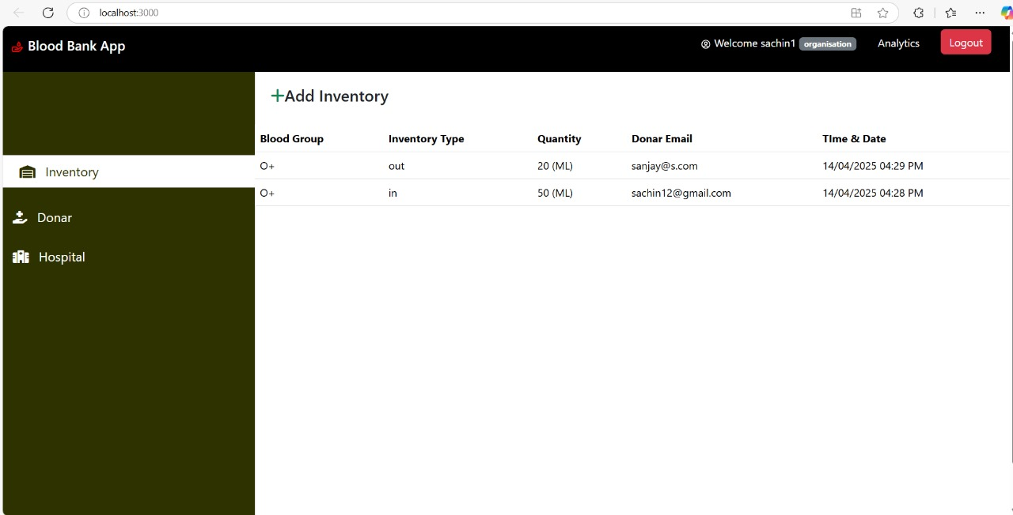
ORGANIZATION DASHBOARD
Figure No. 6

Slide 12
KEY FEATURES
User Authentication (Doners and Recipients)
Blood Group Search and Filtering
Real-Time Blood Stock Updates
Notification for Emergency Blood Requirements

Slide 13
MERN STACK OVERVIEW
MongoDB: NoSQL database for managing data.
Express.js: Backend framework from RESTful APIs.
React.js: Frontend library for user interface.
Node.js: Server side runtime for handling request.

Slide 14
APPLICATION ARCHITECTURE
Frontend : React.js for dynamic, responsive UI.
Backend : Node.js with express.js for API development.
Database : MongoDB to store user and blood data.
Integration : REST APIs for seamless communication.

Slide 15
RESULT
The results of a Blood Bank Web Application
Efficient Donor & Recipient Management
Real-time Blood Availability Tracking
User Authentication & Role Management
Automated Donation Requests & Approvals
Location-based Search
Inventory Management System
Donation History & Reminders
Emergency Notifications & Alerts
Mobile-Friendly & Responsive UI
Data Security & Privacy

Slide 16
Thank You

